Slide 1
Tech.Base
Reference

Slide 2
Sommaire
Clean Architecture
Web
.Net
Angular
Annexe

Slide 3
Clean Architecture
01

Slide 4
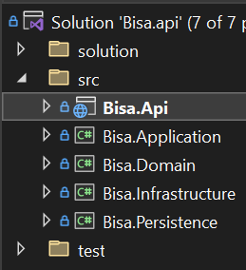
Clean Architecture
Pattern
Projects
Presentation
User Interface (Si App)
Layout. (Si App)
Pages / Components. (Si App)
Assets. (Css / Js / Icon / Svg…)
Middlewares.
Application
Business Logic
Mappers.
Dtos.
Services. Middleware
Validators.
Ui
Application
Infrastructure
Domain
Domain
Coeur de l’application
Attributes.
Configuration. Conf model
Enums. (avec Extensions)
Entities. (Si Api)
Exceptions.
Infrastructure
External components in interaction
HttpClients. Apis
HttpHandlers. Middleware
Consumer. Message Broker (Kafka)
Code Organisation
1 dossier / feature
1 fichier / classe
Le contenu de la solution VisualStudio est sync avec les dossiers & fichiers réels

Slide 5
Web
02

Slide 6
Html | Css | Ts
Web
Html
Balise, Attribut <balise></balise>
<head><body>
<a>, <p>, <button>, <video>…
Typescript
Variable, type, enum
Function
Class, Object, Property
Cloner un objet
Interface & Héritage
Public | Privé
Modifiers (readonly, optionnal…)
Module
Decorator (~Annotation de classe)
…
Css
Selector, attribute, class
Pseudo-elt (:), Pseudo-class (::)
Display. inline, block, flex / grid…
Unité. px, em, rem, %, fr
Flex. container / direction / wrap / grow…
Position / margin / padding…

Slide 7
.Net
03

Slide 8
Overview
.Net
C#
Variable | Type | Comment
Enum | Record | Class
Property | Method | Modifiers
Decorator (= Annotation)
Interface | Inheritance
Reflexion | Introspection
Multi-Threading
C#10. 'state with { change }’
Extension Methods (Ex)
?? Operator
« @ » Multi-line string
« $"{var}" » Param string
Async / Await / Task
Enumerable.Aggregate
Throw new XxxException
Class
Nommage
Contenu Ordonné
Classe
Propriété
Constructeur
Method Public
Method Privée
Technology
Sql | Linq
Database, table, requête, donnée, index
Select, From Where, Join OrderBy
Date
DateTime
Pattern
Dependancy Injection
Mapping
Lib. AutoMapper | DI
Learn | Conf ac Profile
Accessible par DI
Gérer les Collections
Service
Output. IEnumerable
déporter la gestion de l'exé du côté framework
Throughput. List
Comment
Summary
// Todo <=> Code à re-travailler
Api Call
HttpClient | Exemple
HttpClientFactory. Lib | Learn1 | Learn2
Http Message Handler | Http StatusCode
Json Serialize/Deserialize

Slide 9
Specific Stack
.Net
.Net Api
.Net Blazor
Api
Middleware
Controllers | Filters
Controller Resp
Services
Api
Dtos
StartUp / Program
ConfigureService
Service options
Configuration
Component
Overview
Syntax. Razor (@{})
Lifecycle
Type Genericity
Data Binding
Event Handling
Templated Component (=Content Projection)
Style Isolation (Ex)
Routing
Blazor (Tutorial. Codemaze)
Blazor @page '<route>’
Pattern
Service Injection
@using & _Import.
JsInterop
Real Time Server To Client (SignalR)
.Net Mvc
 | Web Assembly | Server
Page Loading | Heavy1st load (Retrieve Dll) | Only get page (Html / Css / Js)
Data Access | Through Api (to_create) | Direct Access
Code Exe° | In client browser | On server
Server Load | Only on 1st app loading | Client have a SignalR connexion with the server

Slide 10
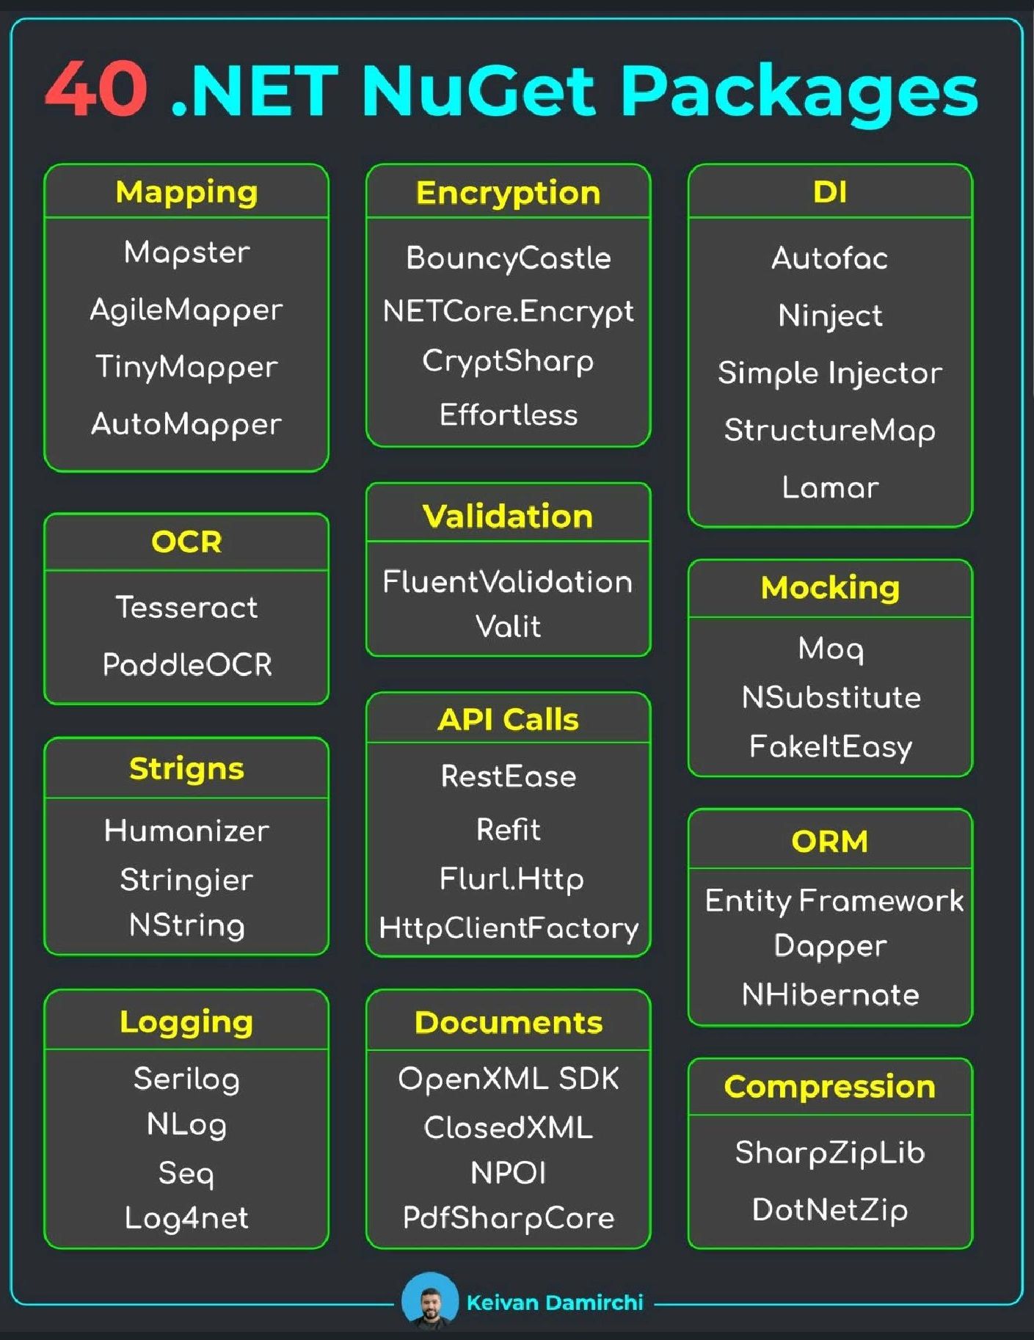
References
.Net

Slide 11
Angular
04

Slide 12
Angular
Angular
Modularity
Module
Component (.html, .css, .ts)
Service : Injectable (DI)
Infrastructure
Http Client
Http Interceptor
Pipe
Resolver
A Creuser
Web Worker
Service Worker
Pour PWA !
Angular Universal
Resolvers. (à creuser)
i18n
Modularity
Router
Directive
Model | Enum
Guard

Slide 13
Material | Ngrx | Rxjs
Angular
Material
mat-form-field
mat-icon
mat-button
…
Ngrx
Store | State
Action | Reducer | Selector | Effect,
Entity | Adapter
Router-store | Store-devtools
Rxjs
Observable / Subject
tap, map, filter, of, first
switchMap, exhaustMap…

Slide 14
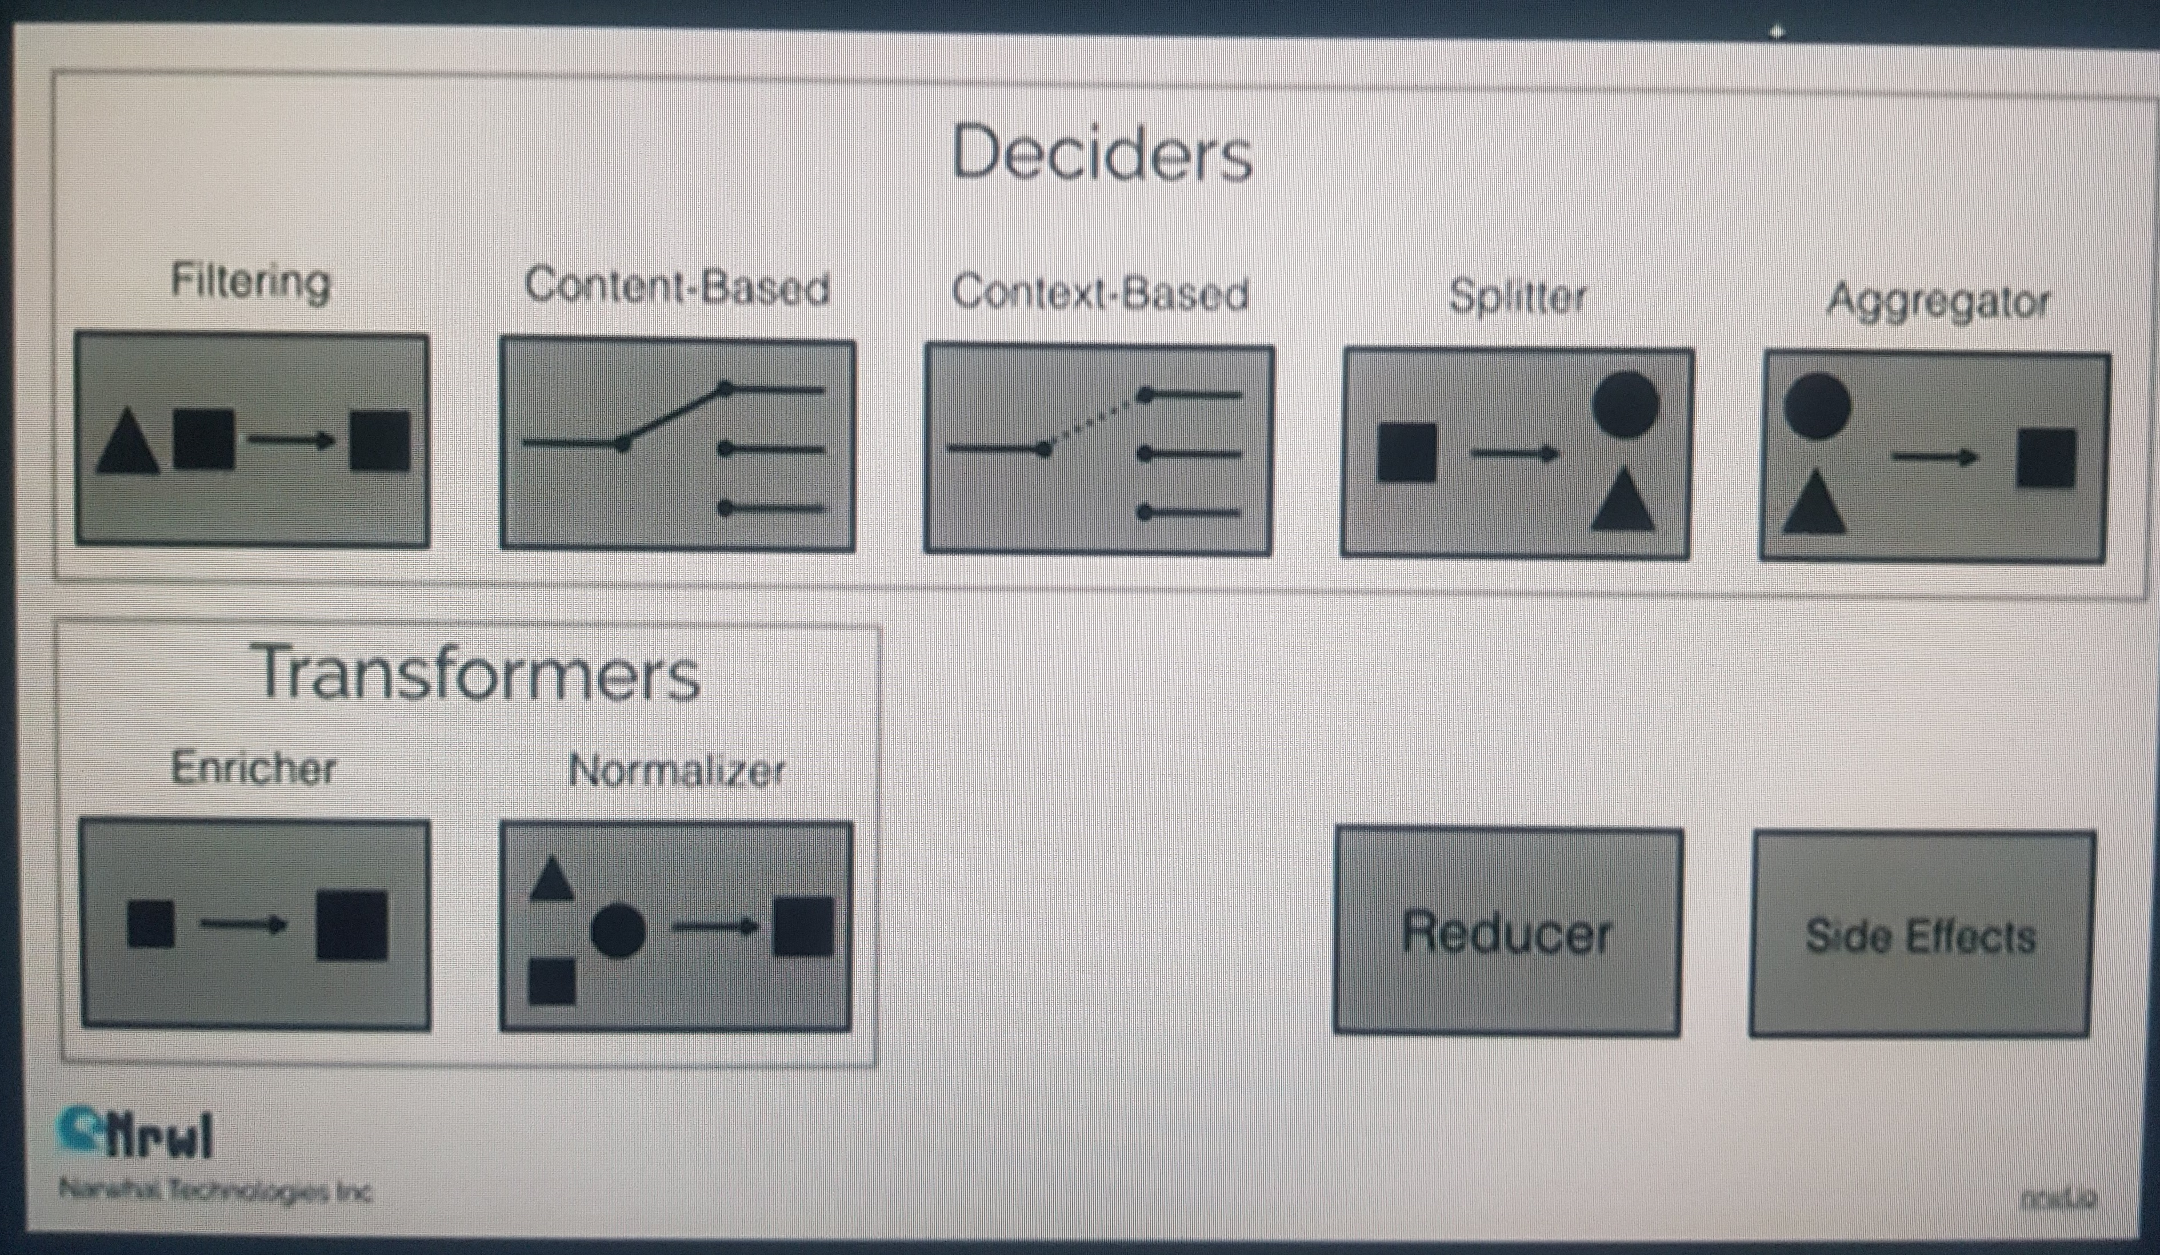
References
Angular

